Slide 1
2024-07-04_S26-S27-S28-S29
S2x_Icell_t1800_C0010_J01
Gottfrid Olsson

Slide 2
Goals with this session
Investigate if a larger Li (12 mm diameter) and/or ‘polished’ Li leads to more uniform deposition
Take a look at Josef’s 1mm Li sample

Slide 3
I’ll use 10kV3.0nA
SED multiplier: 1571 V
Contrast 15%
Brightness 73%, 52%

Slide 4
S26_Icell_t1800_C0010_J01_12mmLi

Slide 5
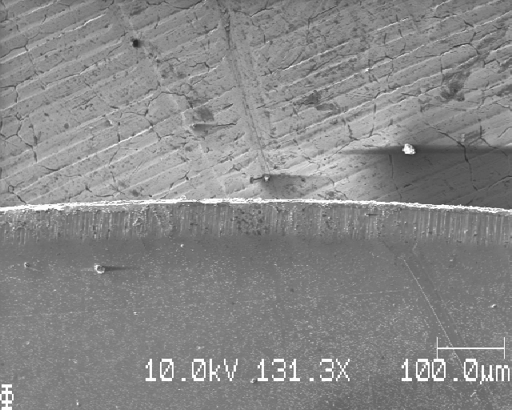
S26: top edge, moving down dy=1mm

Slide 6
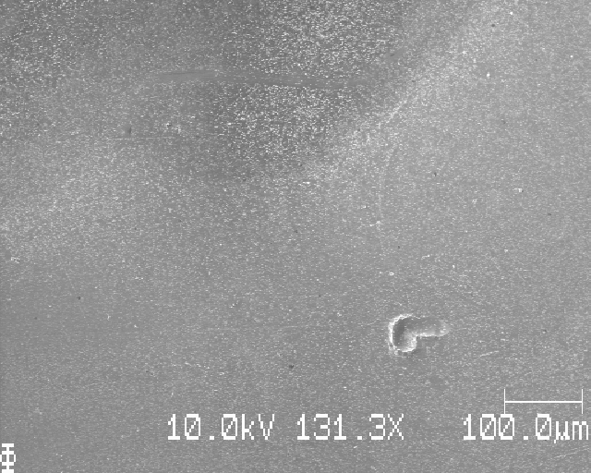
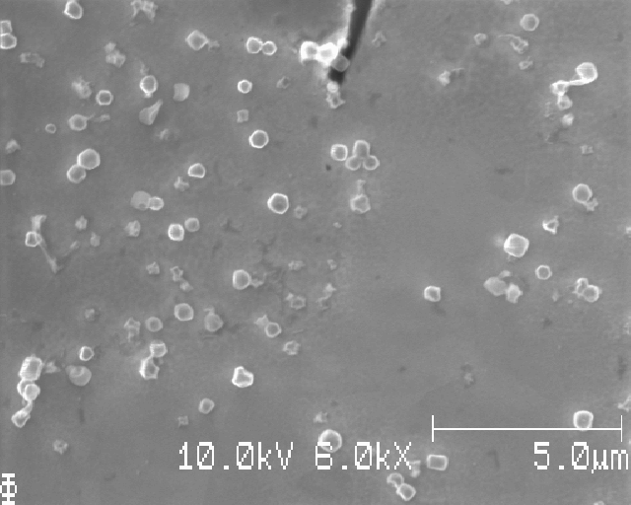
S26:

Slide 7
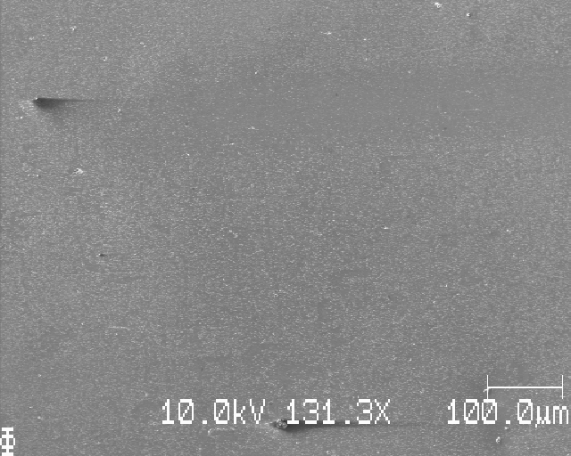
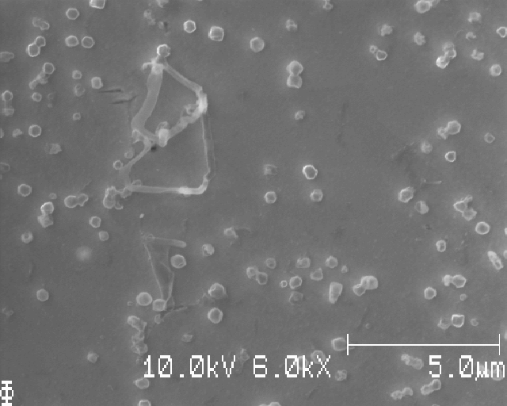
S26:

Slide 8
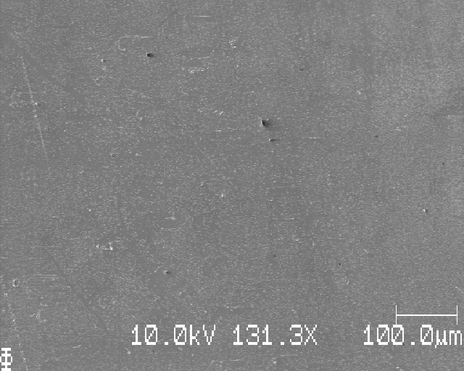
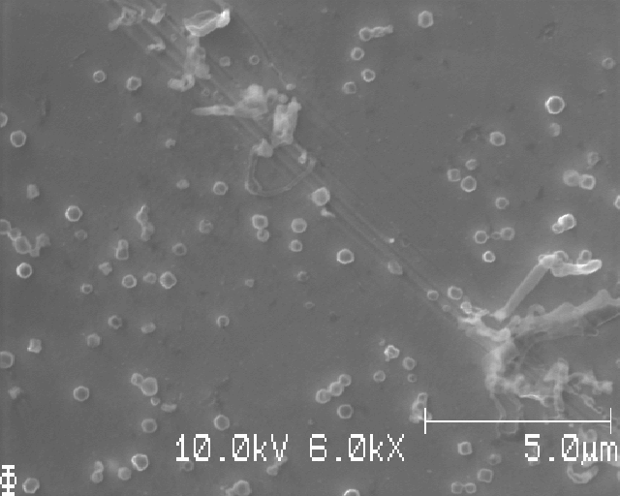
S26:

Slide 9
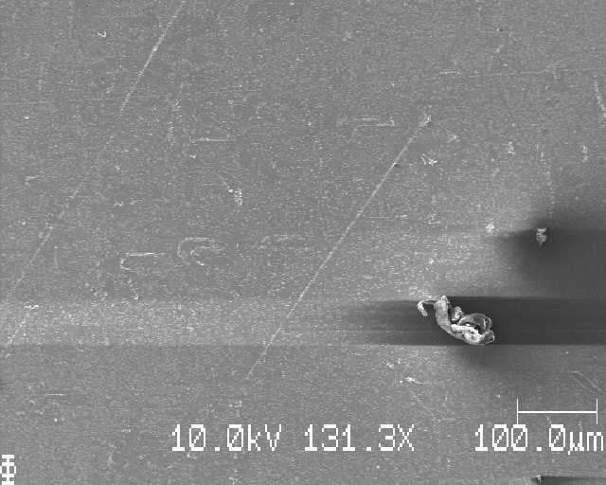
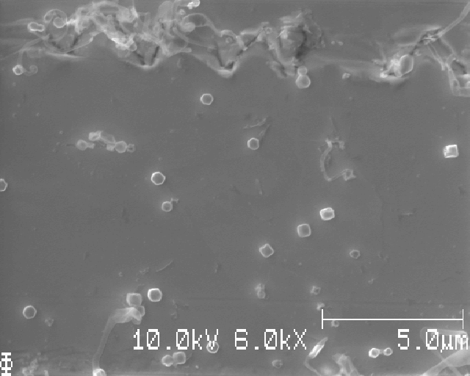
S26:

Slide 10
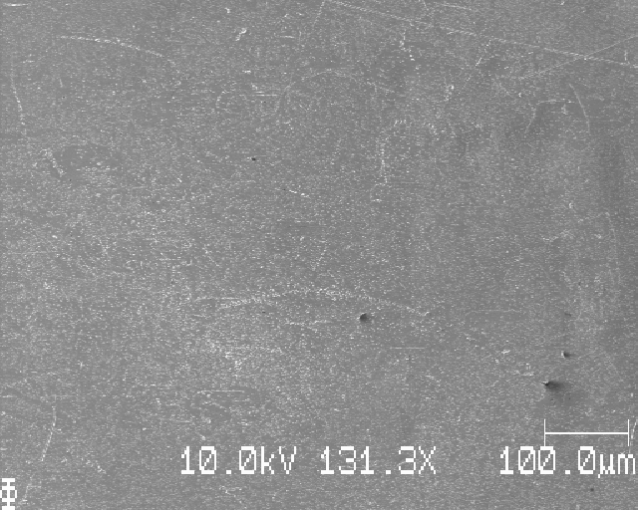
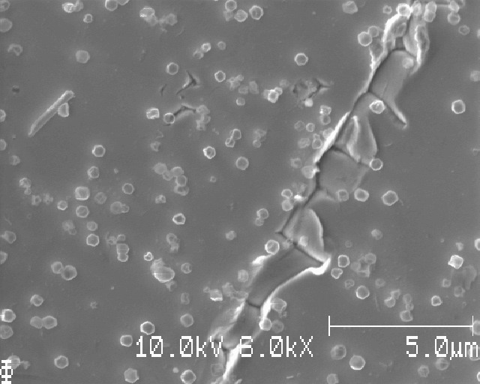
S26:

Slide 11
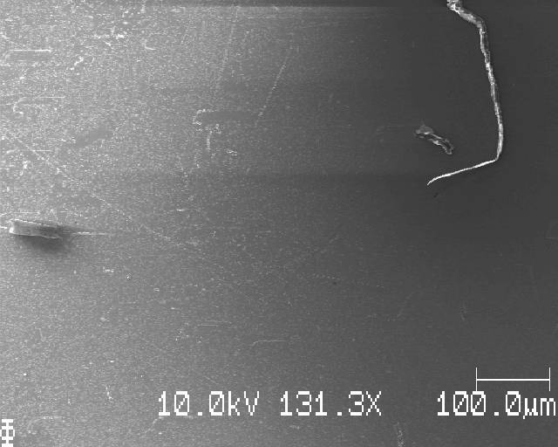
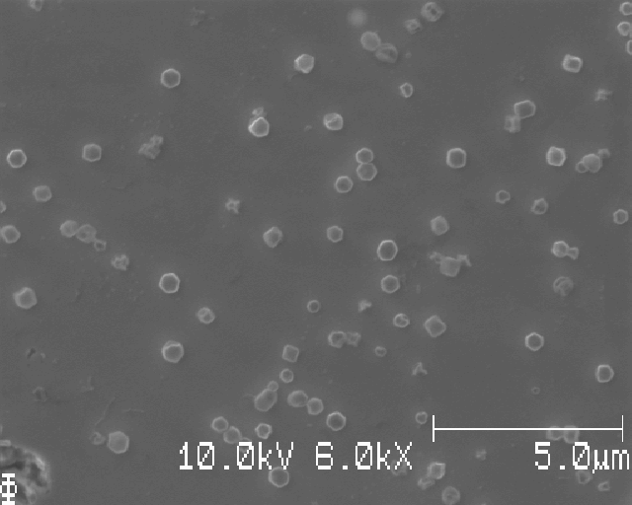
S26:

Slide 12
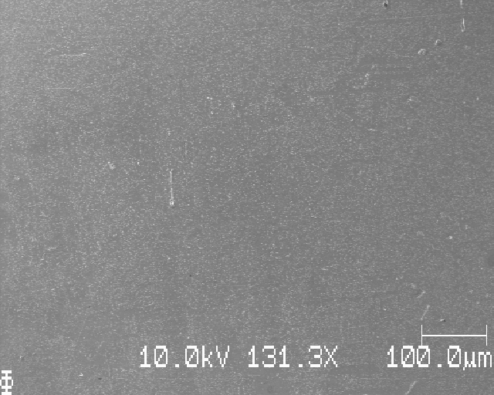
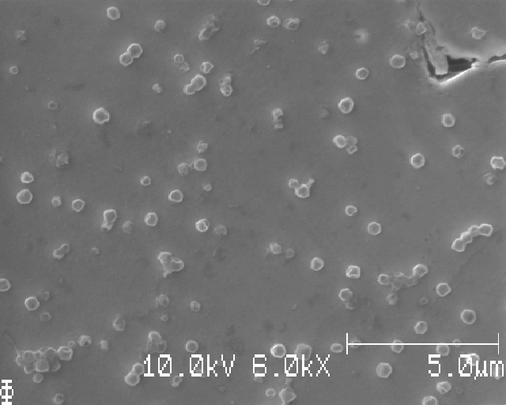
S26:

Slide 13
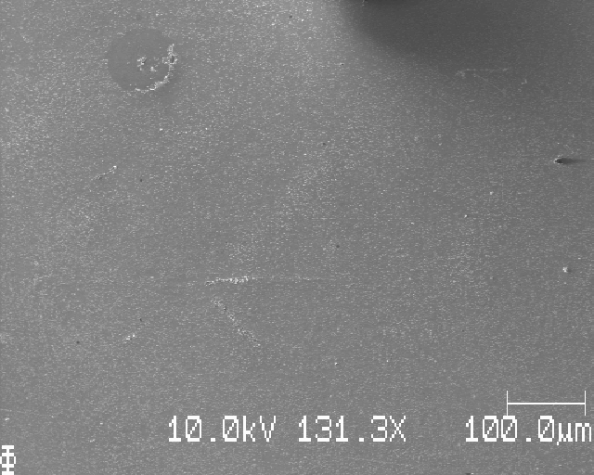
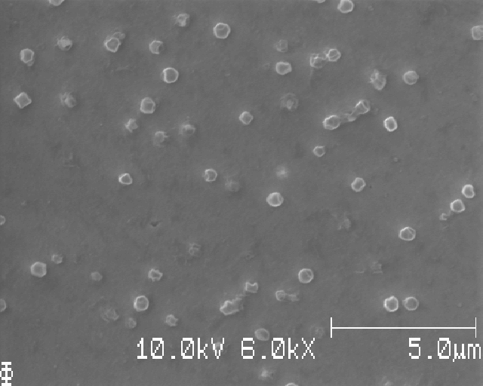
S26:

Slide 14
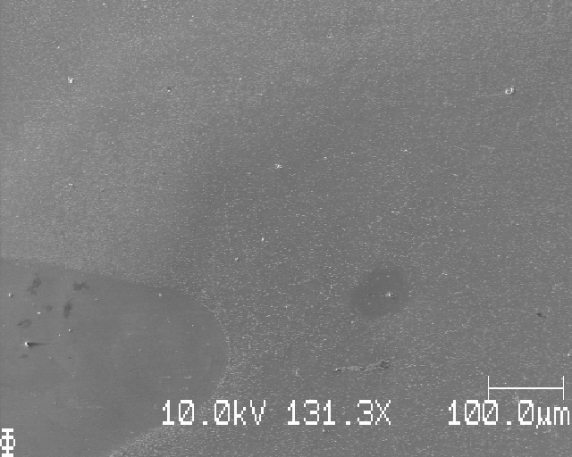
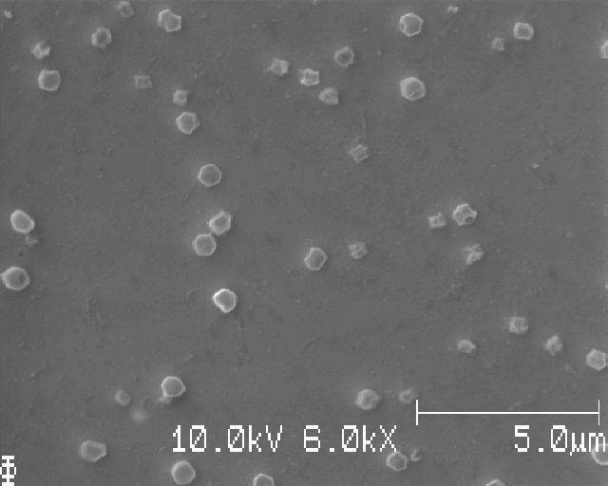
S26:

Slide 15
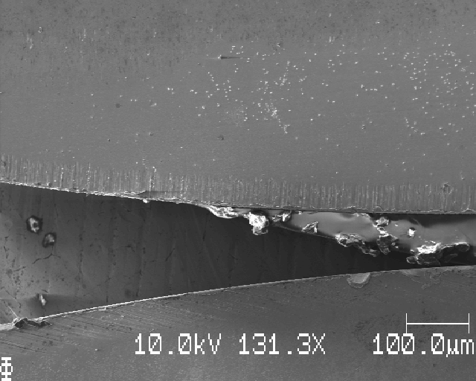
S26: bottom edge of sample

Slide 16
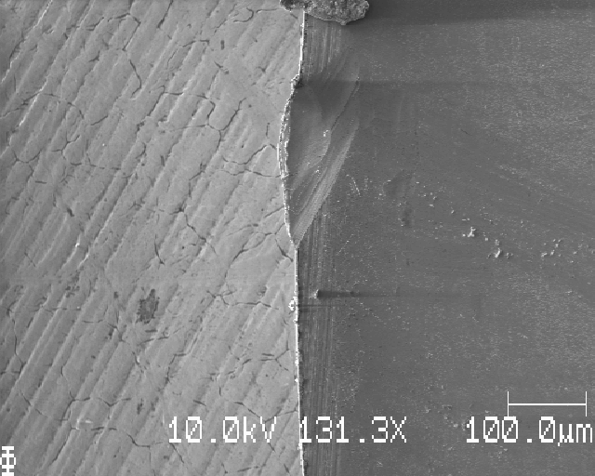
S26: right edge, moving right dx=1mm

Slide 17
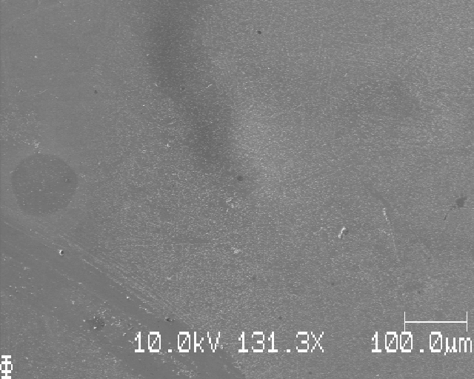
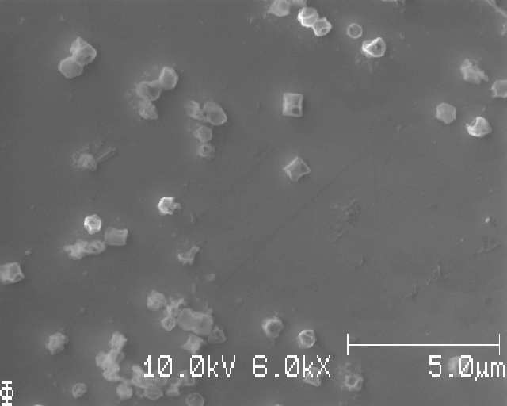
S26:

Slide 18
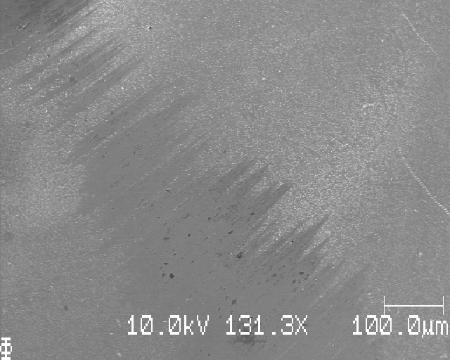
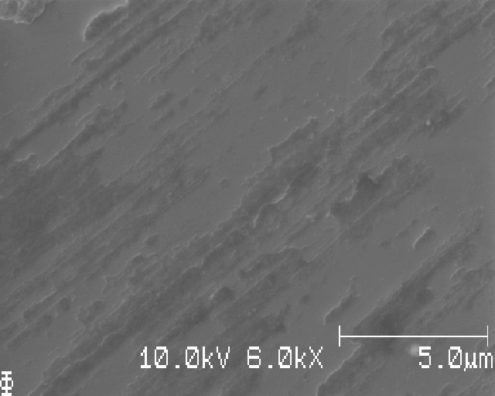
S26:

Slide 19
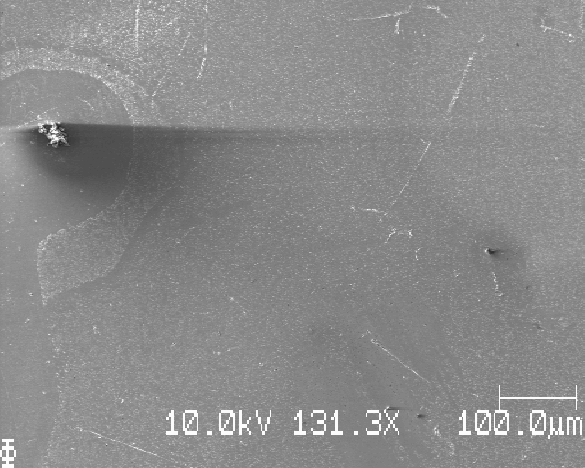
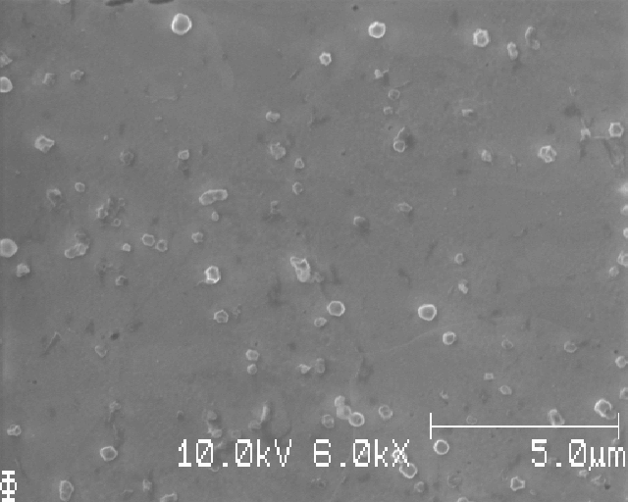
S26:

Slide 20
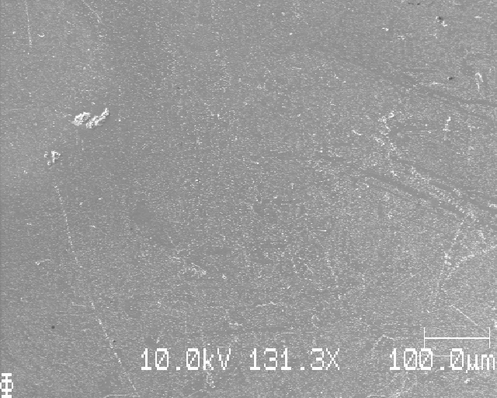
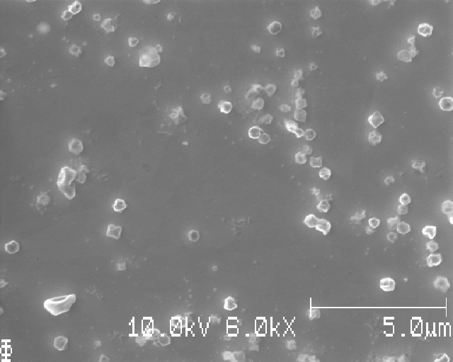
S26:

Slide 21
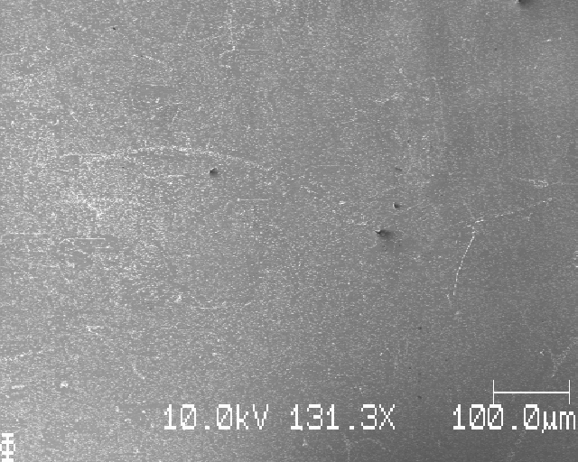
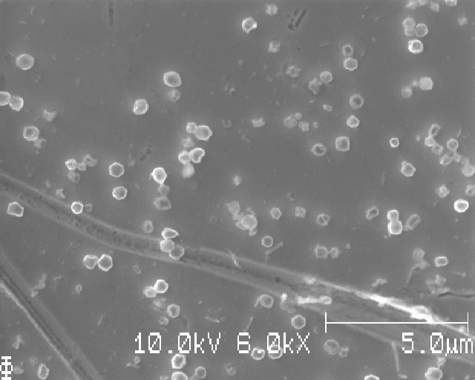
S26:

Slide 22
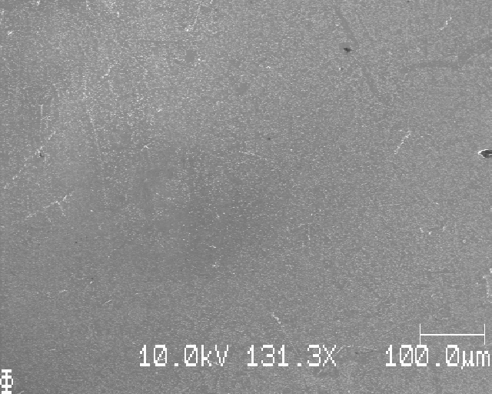
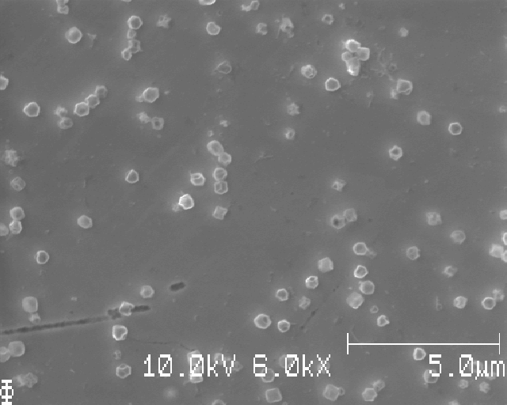
S26:

Slide 23
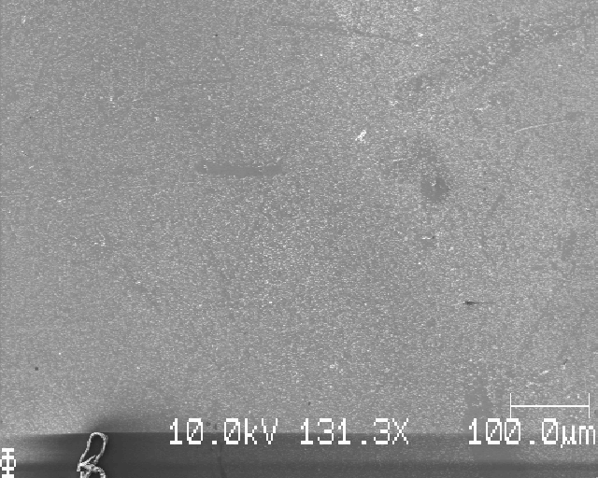
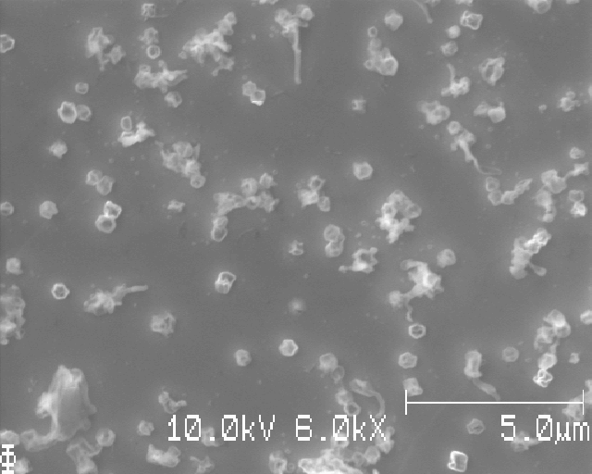
S26:

Slide 24
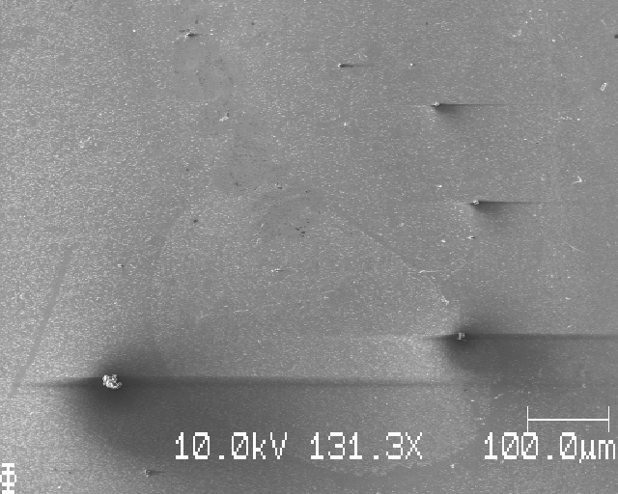
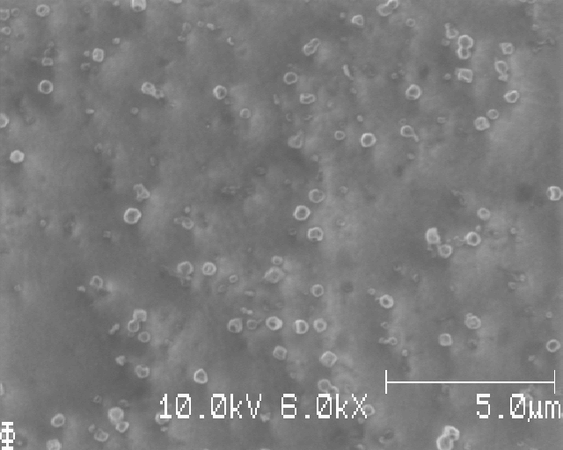
S26:

Slide 25
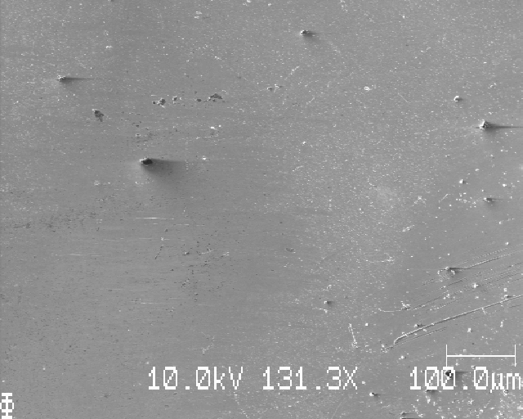
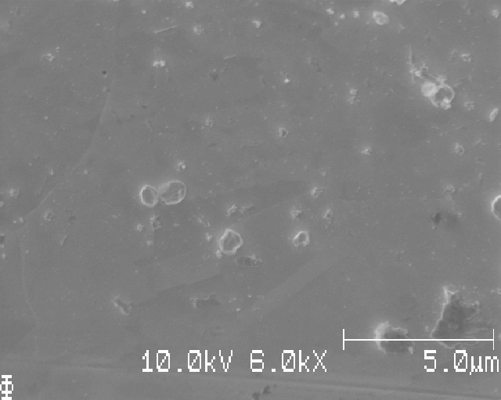
S26:

Slide 26
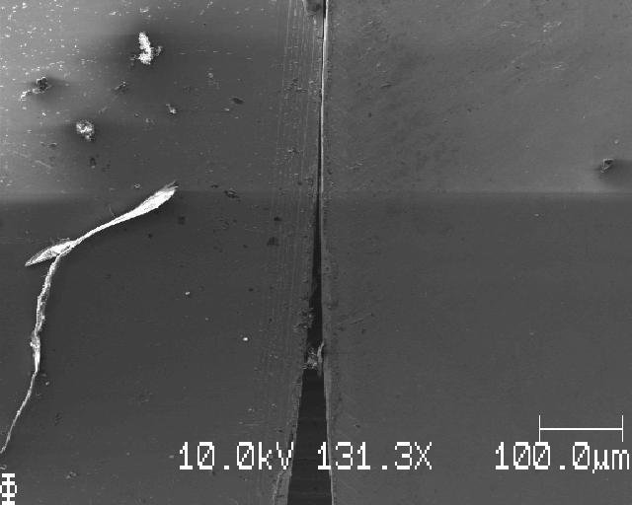
S26: right edge

Slide 27
S26: grid SEM images squares, dx=dy=1000mu

Slide 28
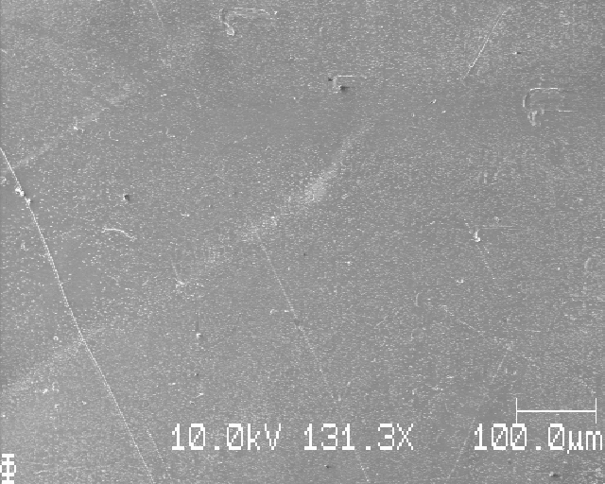
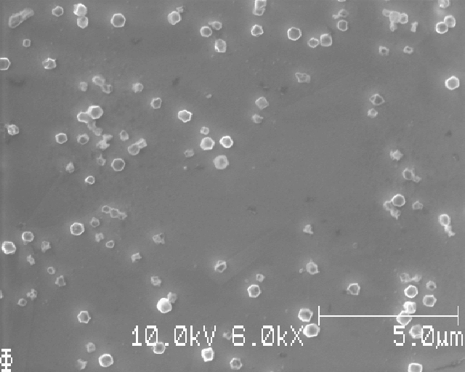
Position 1 of 16
Notes:
Löpande nummer: 1

Slide 29
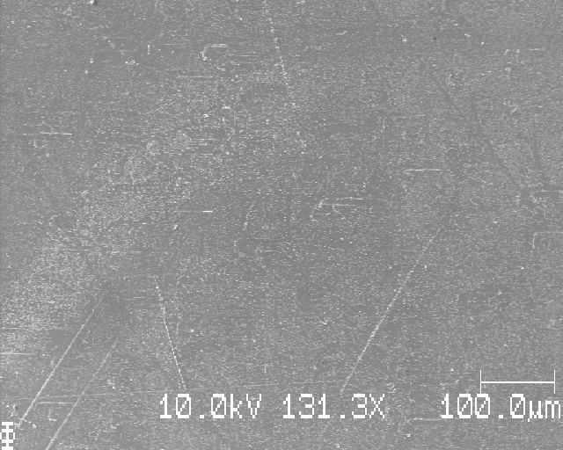
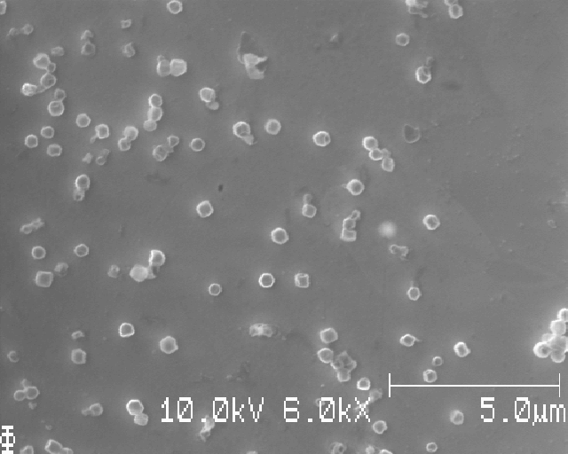
Position 2 of 16
Notes:
Löpande nummer: 2

Slide 30
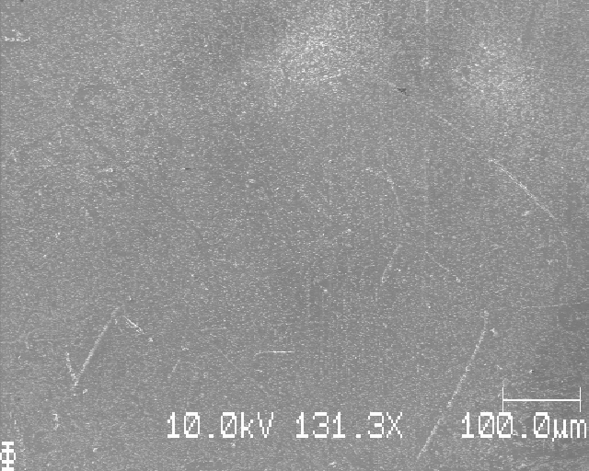
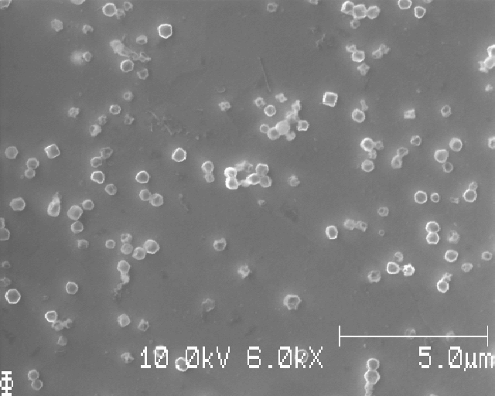
Position 3 of 16
Notes:
Löpande nummer: 3

Slide 31
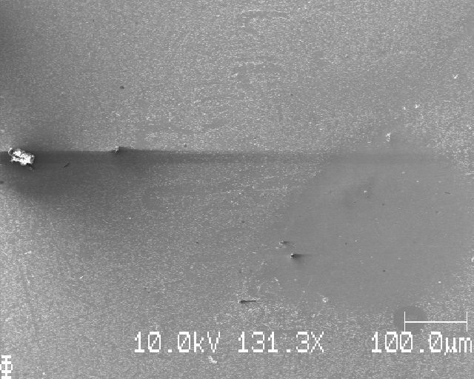
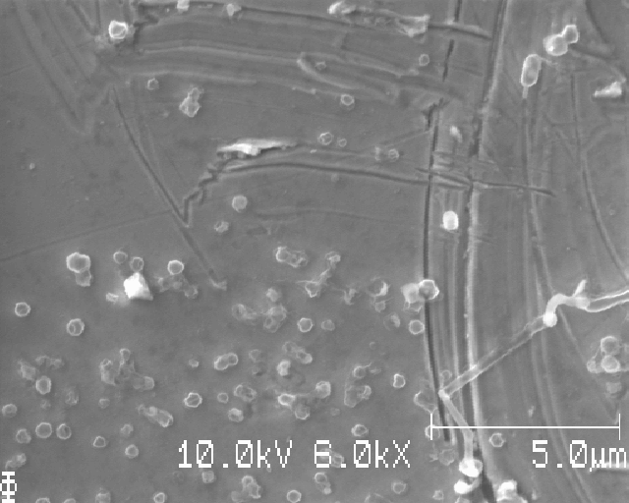
Position 4 of 16
Notes:
Löpande nummer: 4

Slide 32
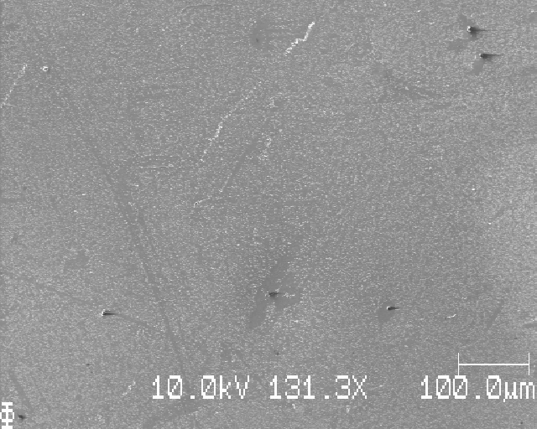
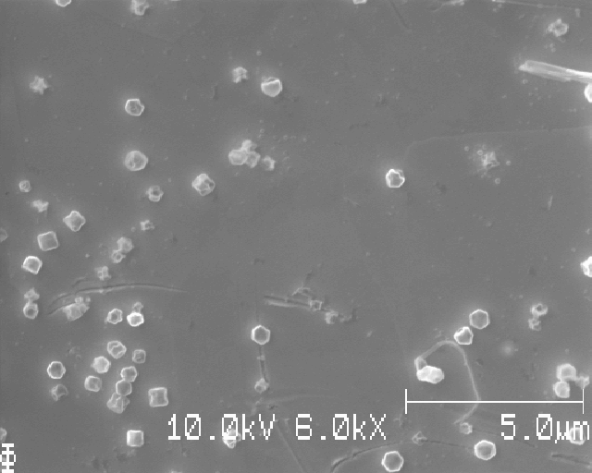
Position 8 of 16
Notes:
Löpande nummer: 5

Slide 33


Position 7 of 16
Notes:
Löpande nummer: 6

Slide 34


Position 6 of 16
Notes:
Löpande nummer: 7

Slide 35


Position 5 of 16
Notes:
Löpande nummer: 8

Slide 36


Position 9 of 16
Notes:
Löpande nummer: 9

Slide 37


Position 10 of 16
Notes:
Löpande nummer: 10

Slide 38


Position 11 of 16
Notes:
Löpande nummer: 11

Slide 39


Position 12 of 16
Notes:
Löpande nummer: 12

Slide 40


Position 16 of 16
Notes:
Löpande nummer: 13

Slide 41


Position 15 of 16
Notes:
Löpande nummer: 14

Slide 42


Position 14 of 16
Notes:
Löpande nummer: 15

Slide 43


Position 13 of 16
Notes:
Löpande nummer: 16 (slut)

Slide 44


Extra, close to each position (avoid bad segmentation): Position 4 of 16

Slide 45


Extra, close to each position (avoid bad segmentation): Position 8 of 16

Slide 46


Extra, close to each position (avoid bad segmentation): Position 10 of 16

Slide 47


Extra, close to each position (avoid bad segmentation): Position 12 of 16

Slide 48


Extra, close to each position (avoid bad segmentation): Position 6 of 16

Slide 49
S26: learning points
Looks pretty good!
If the next sample looks as even w.r.t. the Li deposition, then this is the way to do it!
However, still some unevenness, but given that you take 4x4 images and averages them, I’d say that variation is fine

Slide 50
(next sample)

Slide 51
S27_Icell_t1800_C0010_J01_12mmLi

Slide 52

S27: top edge, moving down dy=1mm

Slide 53


S27:

Slide 54

S27:

Slide 55


S27:

Slide 56


S27:

Slide 57


S27:

Slide 58


S27:

Slide 59


S27:

Slide 60


S27:

Slide 61


S27:

Slide 62

S27: bottom edge of sample

Slide 63
S27:

Slide 64
S27:

Slide 65
S27:

Slide 66
S27:

Slide 67
S27:

Slide 68
S27:

Slide 69
S27:

Slide 70
S27:

Slide 71
S27:

Slide 72
S27:

Slide 73
S27:

Slide 74
S27:

Slide 75
Sxx: grid SEM images squares, dx=dy=1000mu

Slide 76
Position 1 of 16
Notes:
Löpande nummer: 1

Slide 77
Position 2 of 16
Notes:
Löpande nummer: 2

Slide 78
Position 3 of 16
Notes:
Löpande nummer: 3

Slide 79
Position 4 of 16
Notes:
Löpande nummer: 4

Slide 80
Position 8 of 16
Notes:
Löpande nummer: 5

Slide 81
Position 7 of 16
Notes:
Löpande nummer: 6

Slide 82
Position 6 of 16
Notes:
Löpande nummer: 7

Slide 83
Position 5 of 16
Notes:
Löpande nummer: 8

Slide 84
Position 9 of 16
Notes:
Löpande nummer: 9

Slide 85
Position 10 of 16
Notes:
Löpande nummer: 10

Slide 86
Position 11 of 16
Notes:
Löpande nummer: 11

Slide 87
Position 12 of 16
Notes:
Löpande nummer: 12

Slide 88
Position 16 of 16
Notes:
Löpande nummer: 13

Slide 89
Position 15 of 16
Notes:
Löpande nummer: 14

Slide 90
Position 14 of 16
Notes:
Löpande nummer: 15

Slide 91
Position 13 of 16
Notes:
Löpande nummer: 16 (slut)

Slide 92
S27: learning points
The Li deposition looks more or less as even as in S26
However, the Li looks corroded (all of it), which is curious
Still, a larger Li (12mm in diameter) seems to induce much more even Li deposition than a smaller (5 mm in diameter) Li

Slide 93
(next sample)

Slide 94
S28_Icell_t1800_C0010_J01_12mmLiPolished

Slide 95

S28: top edge, moving down dy=1mm

Slide 96


S28:

Slide 97


S28:

Slide 98


S28:

Slide 99


S28:

Slide 100


S28:

Slide 101


S28:

Slide 102


S28:

Slide 103


S28:

Slide 104


S28:

Slide 105

S28: bottom edge

Slide 106
S28:

Slide 107
S28:

Slide 108
S28:

Slide 109
S28:

Slide 110
S28:

Slide 111
S28:

Slide 112
S28:

Slide 113
S28:

Slide 114
S28:

Slide 115
S28:

Slide 116
S28:

Slide 117
Sxx: grid SEM images squares, dx=dy=1000mu

Slide 118
Position 1 of 16
Notes:
Löpande nummer: 1

Slide 119
Position 2 of 16
Notes:
Löpande nummer: 2

Slide 120
Position 3 of 16
Notes:
Löpande nummer: 3

Slide 121
Position 4 of 16
Notes:
Löpande nummer: 4

Slide 122
Position 8 of 16
Notes:
Löpande nummer: 5

Slide 123
Position 7 of 16
Notes:
Löpande nummer: 6

Slide 124
Position 6 of 16
Notes:
Löpande nummer: 7

Slide 125
Position 5 of 16
Notes:
Löpande nummer: 8

Slide 126
Position 9 of 16
Notes:
Löpande nummer: 9

Slide 127
Position 10 of 16
Notes:
Löpande nummer: 10

Slide 128
Position 11 of 16
Notes:
Löpande nummer: 11

Slide 129
Position 12 of 16
Notes:
Löpande nummer: 12

Slide 130
Position 16 of 16
Notes:
Löpande nummer: 13

Slide 131
Position 15 of 16
Notes:
Löpande nummer: 14

Slide 132
Position 14 of 16
Notes:
Löpande nummer: 15

Slide 133
Position 13 of 16
Notes:
Löpande nummer: 16 (slut)

Slide 134
S28: learning points
Reasonable even Li, but still a bit uneven in places
Polishing of Li by scraping of the top oxide layer with a scalpel did not give rise to obvious preferred Li deposition – in other words, it seems to have worked fine
One difference between this and S26 is that there are very little if any corroded Li particles – we only see nice crystalline particles here

Slide 135
(next sample)

Slide 136
S29_Icell_t1800_C0010_J01_12mmLiPolished

Slide 137

S29: top edge, moving down dy=1mm

Slide 138


S29:

Slide 139


S29:

Slide 140


S29:

Slide 141



S29:

Slide 142


S29:

Slide 143


S29:

Slide 144



S29:

Slide 145


S29:

Slide 146


S29:

Slide 147
S29: bottom edge of sample

Slide 148
S29:

Slide 149
S29:

Slide 150
S29:

Slide 151
S29:

Slide 152
S29:

Slide 153
S29:

Slide 154
Sxx: grid SEM images squares, dx=dy=1000mu

Slide 155
Position 1 of 16
Notes:
Löpande nummer: 1

Slide 156
Position 2 of 16
Notes:
Löpande nummer: 2

Slide 157
Position 3 of 16
Notes:
Löpande nummer: 3

Slide 158
Position 4 of 16
Notes:
Löpande nummer: 4

Slide 159
Position 8 of 16
Notes:
Löpande nummer: 5

Slide 160
Position 7 of 16
Notes:
Löpande nummer: 6

Slide 161
Position 6 of 16
Notes:
Löpande nummer: 7

Slide 162
Position 5 of 16
Notes:
Löpande nummer: 8

Slide 163
Position 9 of 16
Notes:
Löpande nummer: 9

Slide 164
Position 10 of 16
Notes:
Löpande nummer: 10

Slide 165
Position 11 of 16
Notes:
Löpande nummer: 11

Slide 166
Position 12 of 16
Notes:
Löpande nummer: 12

Slide 167
Position 16 of 16
Notes:
Löpande nummer: 13

Slide 168
Position 15 of 16
Notes:
Löpande nummer: 14

Slide 169
Position 14 of 16
Notes:
Löpande nummer: 15

Slide 170
Position 13 of 16
Notes:
Löpande nummer: 16 (slut)

Slide 171
S29: learning points
lorem

Slide 172

Josef’s 1mm Li sample

Slide 173

Beam damage in the middle(?): right side

Slide 174

Left side

Slide 175


Slide 176

They bubble when imaged

Slide 177



Slide 178


Same place as previous slide

Slide 179

Raster scan in SEM →grid-like black dots on something reacts

Slide 180




